Slide 1
NNSA RPV APPROACH
National Nuclear Security Administration
May 2018

Slide 2
BUILDER Overview

Slide 3
BUILDER SMS
A part of a web-based software application Sustainment Management System (SMS)
Developed by Construction Engineering Research Laboratory (CERL), Engineer Research and Development Center, US Army Corps of Engineers
To help engineers, technicians and managers decide when, where and how to best maintain building infrastructure
Detailed real property inventory per UNIFORMAT II
Condition assessment and projection of expected condition with respect to the expected life cycle deterioration.
Mandated for DOD and other federal agencies

Slide 4
BUILDER SMS PROCESS
Inventory
Real Property Inventory (from FIMS/G2)
Component Inventory
Assessment
Condition Assessment
Functionality Assessment
Analysis
Condition Index Analysis
Work Planning
Work Generation
Forecasting
Course of Action (COA) Analysis
Work Prioritization
“What If ?” Scenarios
Remaining Service Life
BUILDER SMS
Local CMMS
Programs work together to provide a full service asset management product
(CMMS integration still in development stage)

Slide 5
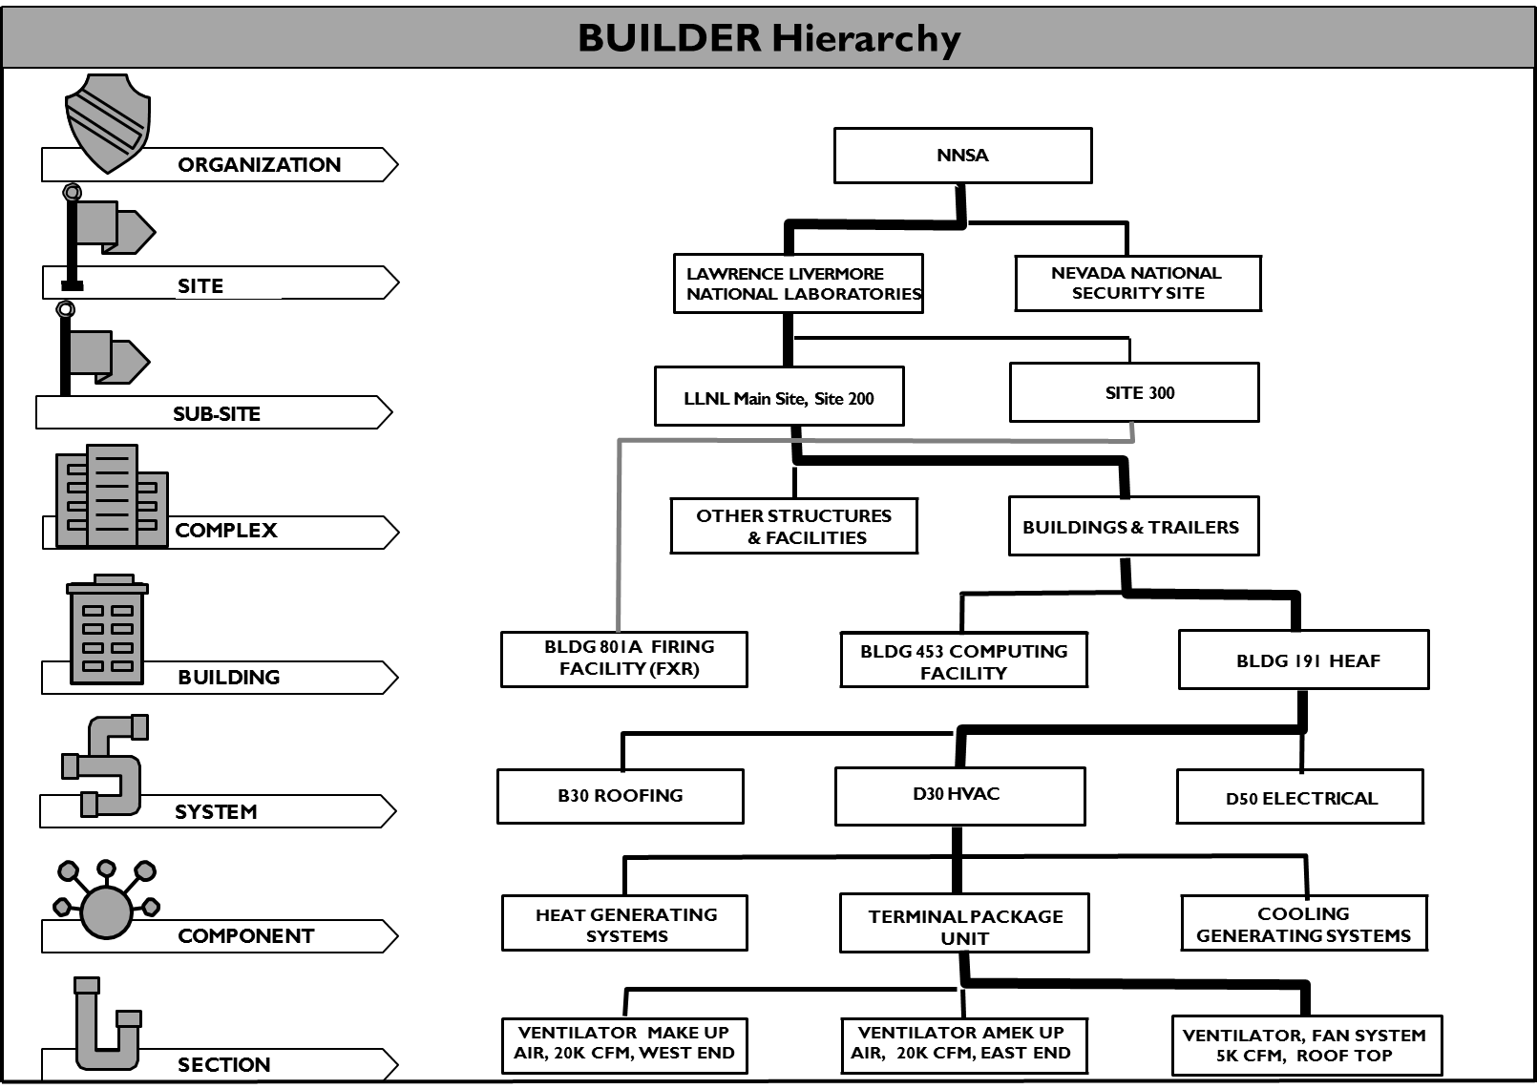
BUILDER INVENTORY HIERARCHY
BUILDER arranges real property inventory in the following way:
  Identifies the customer’s organizational structure
  Organizes that structure into a manageable hierarchy
  Lists facilities which will be independently maintained
  Groups real property building components under each individual facility

Slide 6
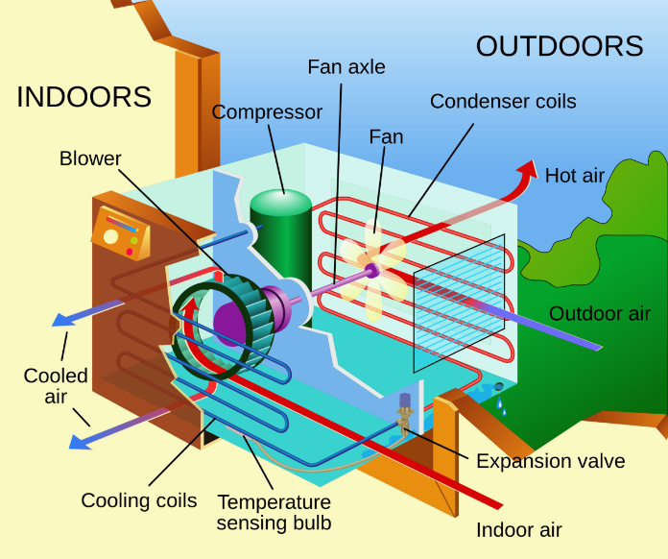
ASSESSMENTS
A/C Unit, Window (12,200 BTU)
  Condition Issues
  Broken
  Clogged
  Corroded
  Cracked
  Damaged
  Deteriorated
  Leaks
  Missing parts
  Functionality Issues
  Capacity (over/undersized)
  Code compliance
  Configuration
  Obsolescence (parts/system)
  Safety Hazards
  Wrong type needed
  Condition
    Condition Index (CI):
      100 – 0 score (Flawless Condition – Complete Condition Failure)
      BUILDER condition data is collected at the Level 5, Section Sub-Type level (e.g., “Hoists, 15' lift, 1 ton” or “Generators - Diesel, 175 kW”)
  Functionality
    Functionality Index (FI):
      100 – 0 score (Fully Meets Mission – Complete Failure to Meet Mission)
      BUILDER functionality data will be collected at the Asset Level and be primarily system-focused (e.g., HVAC in HEAF)

Slide 7
RPV Approach & CMMS Integration

Slide 8
REPLACEMENT PLANT VALUE (RPV)
Current Challenges
  80 RPV models created for Department of Energy by RSMeans
  Unit price driven calculation
  Usage Codes (FACODE/CATCODE in DoD) to determine RPV models
  Out-dated RPV models and unit prices
  Gaps to capture agency unique facilities
  Creates inaccurate RPVs with inaccurate agency RP portfolios
NNSA Approach
  Nationally Recognized and Credible Data Source, Gordain/RSMeans (RSMeans)
  Major Task Items
    Updates
      Update NNSA BUILDER UNIFORMAT II cost catalog based on RSMeans cost data
      Update Service Life information
    RPV Cost Engine
      Update existing RPV models
      Create additional RPV models for NNSA specific needs
      Develop a RPV calculation tool to reflect major asset from BUILDER inventory
      Integration via SPIRE integration tool within NNSA server
    Sustainment
      Initial update
      Annual update

Slide 9
RPV COST ENGINE FLOW DIAGRAM
Create a new RPV calculation tool, Cost Engine
RSMeans Cost Engine utilizes RPV models and BUILDER inventory to generate enhance RPV for NNSA assets
Data Flow
  Cost Engine ‘Scheduler’ initiates a request to update RPVs for NNSA assets
  Cost Engine requests asset information including model IDs and RPUIDs from BUILDER via SPIRE, Integration Tool*
  Cost Engine receives BUILDER inventory via SPIRE*
  Cost Engine generates enhanced RPV and returns to BUILDER via SPIRE to populate the new value
* This may be part of the same service/step

Slide 10
CMMS/BUILDER INTEGRATION OVERVIEW
Integration Objectives
  Separate & Stand-alone programs: potentially cost/labor prohibitive to maintain infrastructure data, no current interface/connection
  Integration of NNSA BUILDER (planning tool) with NNSA CMMS Systems (execution tool)
  Better NNSA Infrastructure Management
    Data Interface between NNSA BUILDER and CMMS
    Benefits to HQ’s and Sites from the integration by automated data transfer between BUILDER and CMMS.
  Challenges
    9 sites with up to 6 different CMMS programs
    Various different cybersecurity protocols
Overall Process
  Data exchange: BUILDER – Integration Tool – CMMS
  Progress
    Develop Integratiosn Tool, SPIRE
    Pilot Integration@ LANL (AssetSuite) & SNL (MAXIMO)
    Two additional sites in FY18 @ LLNL (legacy DB) & NNSS (MAXIMO)

Slide 11






INTEGRATION FLOW
Site Network
CMMS
Any CMMS
G2 Data Center @ ORNL
CMMS
Site Network
NNSA
BUILDER Database
BUILDER API
SPIRE (DIGON
Integration Application)
CMMS
Integration Options
Real-Time API
Scheduled Batch API
Batch File
CMMS

Slide 12

Questions?

